Slide 1
Programming in Math First Meeting Lecture Notes #1: Course Overview
Uduak George
Department of Mathematics and Statistics
San Diego State University
San Diego, CA 92182-7720
ugeorge@sdsu.edu
https://ugeorge.sdsu.edu

Slide 2
Contact Information: The Professor
Office GMCS-584
Email ugeorge@sdsu.edu
Web https://ugeorge.sdsu.edu
Phone 619-594-7247
Office Hours W. Th. 12:30-13:30 and by appointment

Slide 3
Course Webpage
Course material (notebooks and syllabus) can be found on Github at: https://github.com/uduakgeorge/M340
You can also view the notebooks and syllabus directly at: https://nbviewer.jupyter.org/github/uduakgeorge/M340/tree/master/Math-340-Notebooks-master/

Slide 4
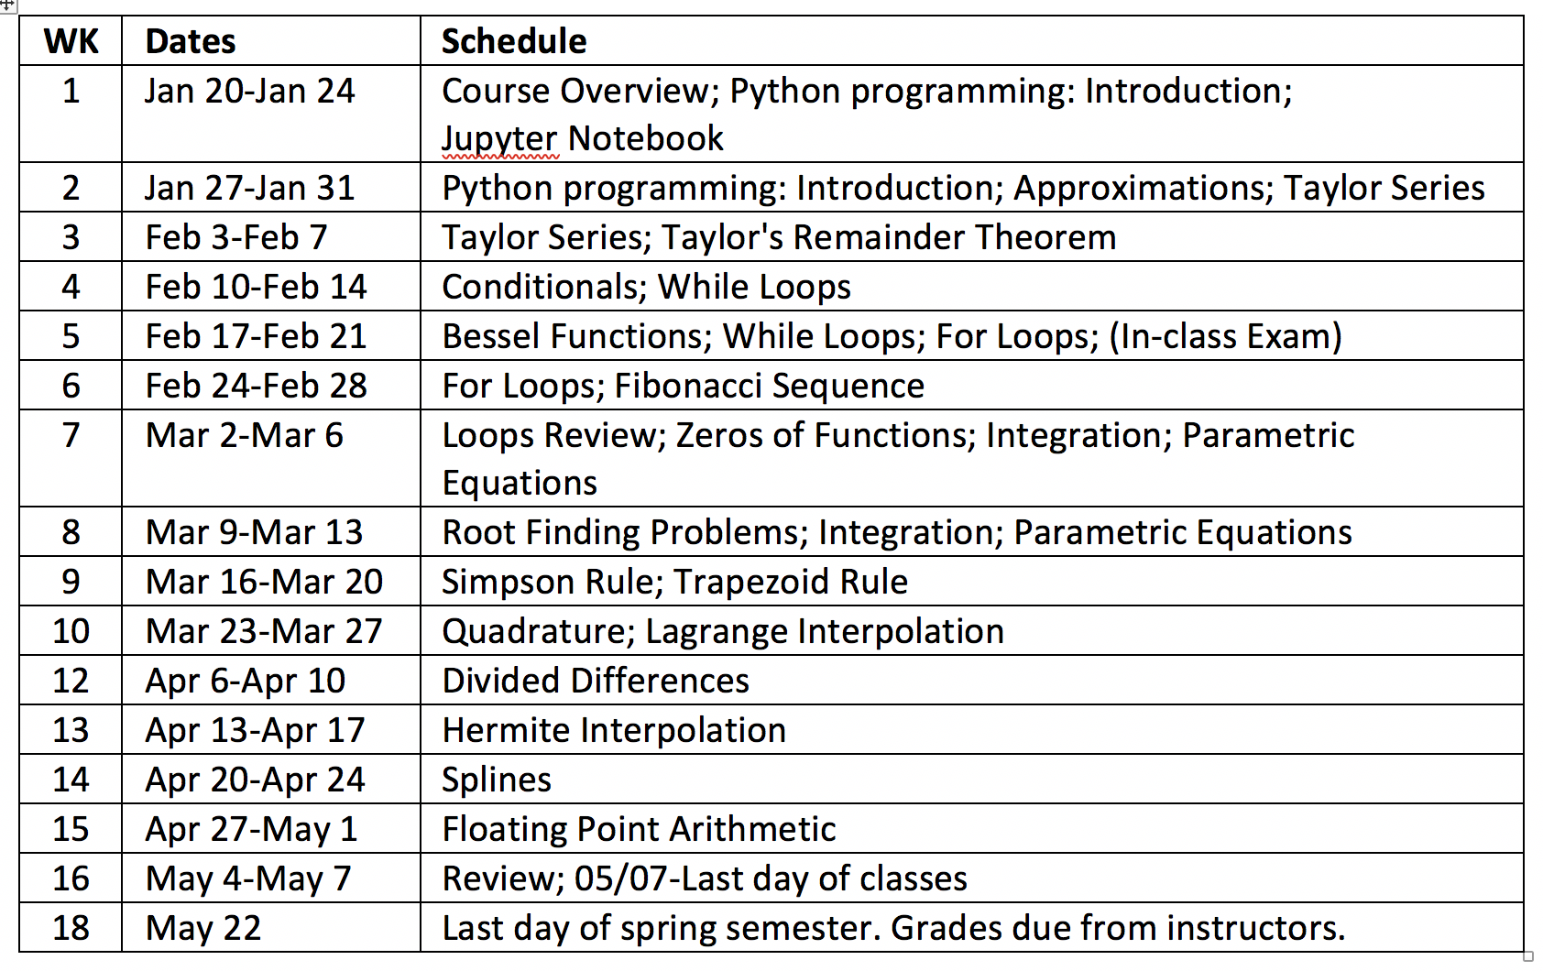
Syllabus

Slide 5
Homework
See course syllabus (available on course webpage) for homework schedule and important dates.
Homework will be submitted via Google Drive, if you do not have a gmail account, please sign up for one by following the link below: https://support.google.com/mail/answer/56256?hl=en
***Email me your Gmail address and I will send you a link for homework submission.

Slide 6
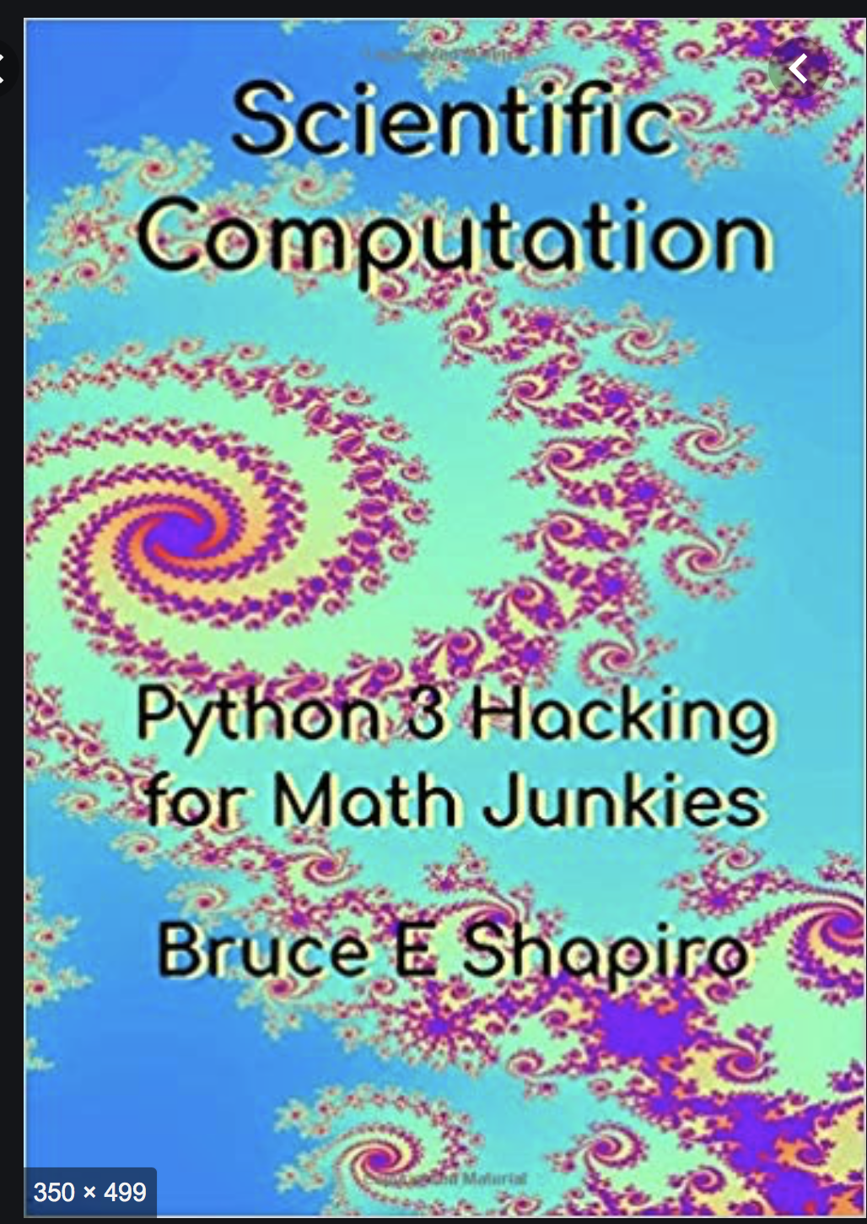
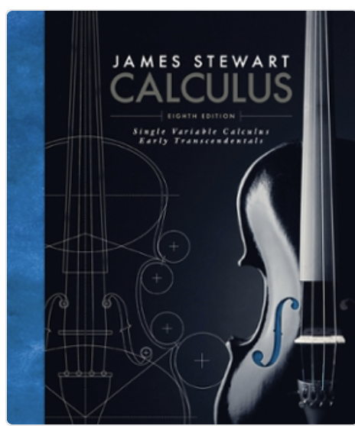
Required and Optional Text
Required Text
Course Notes
Secondary Text
Scientific Computation: Python Hacking for Math Junkies, by Bruce E. Shapiro. ISBN-10: 0692452001; ISBN- 13: 9780692452004. Publisher: Sherwood Forest Books
Single Variable Calculus: Early Transcendentals 8th Edition, by James Stewart. ISBN 978-1-305-27033-6; ISBN-10: 9781305270336; ISBN-13: 978-1305270336. Publisher: Cengage

Slide 7
Grading Scheme
Homework 40%
Two exams 30%
Final exam 30%
The following grading scale will be used:
A 93% - 100% A- 90% - 93%
B+ 87% - 90% B 83% - 87% B- 80% - 83%
C+ 76% - 80% C 72% - 76% C- 68% - 72%
D+ 64% - 68% D 60% -64% D- 55% - 60% F Below 55%

Slide 8
What we will learn
You will learn how to program in Python, typeset mathematical symbols and equations in LaTeX and use Jupyter to present mathematical results.

Slide 9
Course Prerequisites
MATH 151 Calculus II
MATH 245 Discrete Mathematics or equivalent
Or Instructor's permission

Slide 10
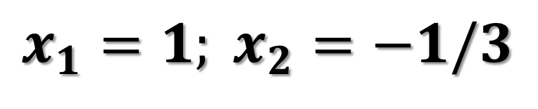
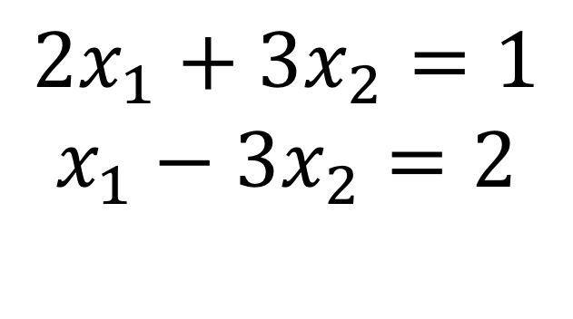
Computer Programming and Mathematics: Importance
Systems of equations in two variables are easy to solve. It gets more time consuming and laborious to solve if you have a system of three or four equations.
$${2x}_{1}+{3x}_{2}=1$$
$$x_{1}−{3x}_{2}=2$$
Applying the substitution method to the system of equations, we obtain the following solutions:
$$x_{1}=1; x_{2}=−1/3$$

Slide 11
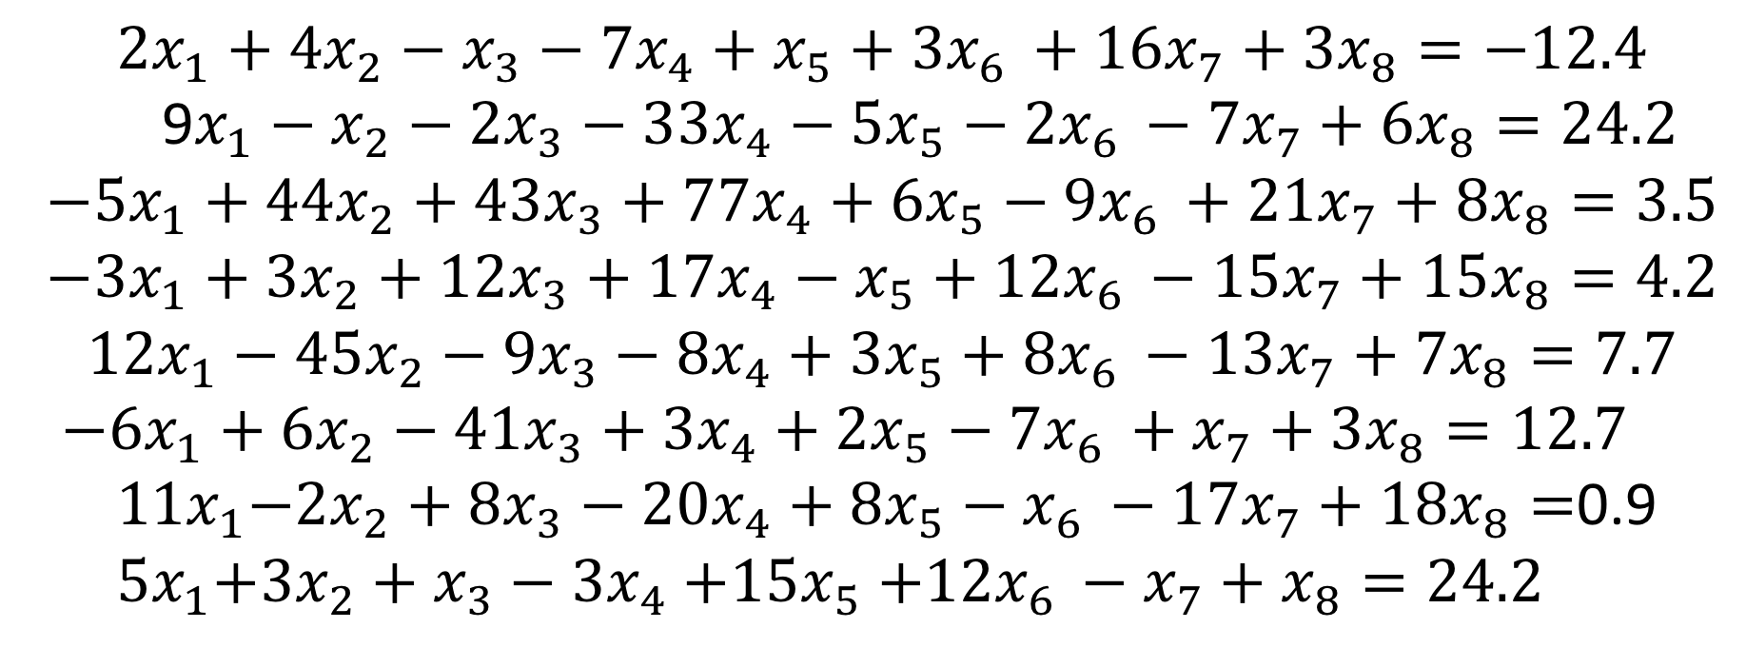
Computer programming can be use to find solutions for the following system of equations
$${2x}_{1}+{4x}_{2}−x_{3}−{7x}_{4}+x_{5}+{3x}_{6 }+{16x}_{7}+{3x}_{8}=−12.4$$
9$x_{1}−x_{2}−{2x}_{3}−{33x}_{4}−{5x}_{5}−2x_{6 }−{7x}_{7}+{6x}_{8}=24.2$
$${−5x}_{1}+{44x}_{2}+{43x}_{3}+{77x}_{4}+{6x}_{5}−9x_{6 }+{21x}_{7}+8x_{8}=3.5$$
$${−3x}_{1}+3x_{2}+{12x}_{3}+1{7x}_{4}−x_{5}+12x_{6 }−{15x}_{7}+{15x}_{8}=4.2$$
$${12x}_{1}−{45x}_{2}−{9x}_{3}−{8x}_{4}+{3x}_{5}+8x_{6 }−{13x}_{7}+{7x}_{8}=7.7$$
${−6x}_{1}+{6x}_{2}−41x_{3}+{3x}_{4}+{2x}_{5}−7x_{6 }+x_{7}+{3x}_{8}=12.7$
${ 11x}_{1}−{2x}_{2}+8x_{3}−{20x}_{4}+{8x}_{5}−x_{6 }−{17x}_{7}+18x_{8}=$0.9
${ 5x}_{1}+3x_{2}+x_{3}−{3x}_{4}{+15x}_{5}+12x_{6 }−x_{7}+x_{8}=24.2$

Slide 12
Computer programming: Solving Laborious Tasks
Python is a programming language that enable us to use computers to solve complex, tedious or difficult tasks.
Example
The sum of numbers from 1 to 1,000,000 can be done easily in Python.

Slide 13
Computer Program
To tell a computer what to do you give it instructions in a computer language.
The name of the language that we will use in this class is Python.
A Computer Program is a sequence of instructions for a computer, so that it can perform a specific task.

Slide 14
Syntax and semantics
The syntax of a computer language describes very precisely how to form statements the computer understands.
If there is any deviation from the rules, even the smallest, the computer will recognize that there is an error, and it will tell you so.
The semantics of a computer program describe what it is supposed to do.
A semantic error that is not a syntactic error will not cause the program to halt. Instead, it will do something funny.

Slide 15
Statement and Code
The instructions in a computer program are called statements.
When you program in python, the text you write is called code.

Slide 16
Why Python?
Python has generic programming structures that are common to other computer languages. If you already know another programming language, then Python is easy to learn.

Slide 17
Why Python?
It is free on all operating systems. Thus students can install it on their laptops or home computers and are not chained to computer labs or expensive license agreements.
Python is completely documented online, and there are lots of books you can download for free to learn more about it.

Slide 18
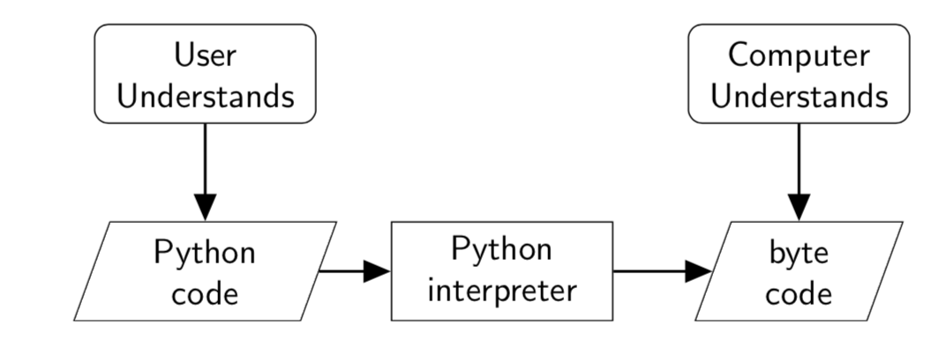
We will use the same word – python – to refer to:
the language (the syntactical rules),
the written language (the code or programs), and
the computer program that translates your python code into machine language or byte code.

Slide 19
Jupyter notebooks
One of the advantages of using notebook is that you can readily access some of the most sophisticated features of python within your browser.
Step-by-step guide to accessing Jupyter notebooks:
Go to (Start-> Anaconda-> Jupyter) to open Anaconda
In Jupyter notebook dashboard, click on new->python 3
Save the new jupyter notebook as lecture 1 demo

Slide 20
Do this following by next class!
Install Anaconda (Python 3.8 version) on your personal computer.
https://www.anaconda.com
If you do not have a gmail account, please sign up for one by following the link:
https://support.google.com/mail/answer/56256?hl=en

